Slide 1

PROJECT ON
JARVIS DESKTOP VOICE ASSISTANT
Guide : Ms. Nandini Sharma
Presented By : Kishan Kumar Rai
Class : B.Tech CSE 6th SEM
Roll No. : 18038004007

Slide 2
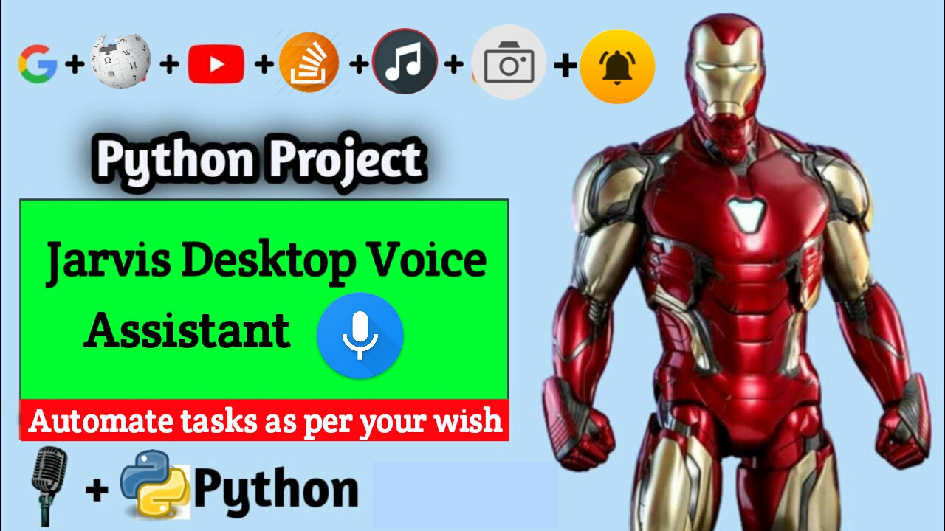

Slide 3
CONTENTS
Introduction
Tools & Technologies
System Requirements
Objective
Modules/Libraries Used
Implementation
Tasks
Advantages/Disadvantages
Scope of the project
Conclusion
References

Slide 4


TOOLS & TECHNOLOGIES
Version : 3.8.3
Version : 1.55.2
SYSTEM REQUIREMENTS
OS : Windows 7 or above
RAM : 4GB or above
Hard Drive : 250 MB HDD
Processor : Intel Dual Core

Slide 5
INTRODUCTION
Have you ever wondered how cool it would be to have your own assistant? Imagine how easier it would be doing Wikipedia searches without opening web browsers, and performing many other daily tasks like playing music with the help of a single voice command, opening different browsers in just a voice command. This project is simple desktop voice assistant built with python named as “Jarvis Desktop Voice Assistant”. This project is fully completed and error free. It was compiled in VS Code Editor.
A virtual assistant, also called an AI assistant or digital assistant, is an application program that understands natural language voice commands and completes tasks for the user. The whole concept based on how can we make our life easier or how can we automate the things by just using our voice command. When the project is being executed then first of all it greets the user as per the time. After that it just listen your command in form of voice and just that that thing according to your command.
It is implemented in “PYTHON Programming Language” in which implementation is very easy. For every sort of work there is module present in python which makes the thing very easy and effective to do. It is user friendly and easy to understandable for new user.

Slide 6
OBJECTIVE
To Become familiar with the concepts of Python Language.
To Implement the concepts of basic and intermediate python operations for making this project used in real life.
To become familiar with different modules and libraries.
To make ease for the users to automate the things by using own voice commands.

Slide 7
Moules/Libraries Used:
Pyttsx3
A python library that will help us to convert text to speech. In short, it is a text-to-speech library.
It works offline, and it is compatible with Python 2 as well as Python 3.
Datetime
To provide current or live time to Assistant.
Used for greeting user according to time.
Speech Recognition
Library for performing speech recognition, with support for several engines and APIs, online and offline.
Used for taking input from microphone as a source to perform tasks.
Wikipedia
Wikipedia is a Python library that makes it easy to access and parse data from Wikipedia.
It helps the user to get results for a particular query or search.

Slide 8
Web Browser
The web browser module provides a high-level interface to allow displaying Web-based documents to users
Under most circumstances, simply calling the open() function from this module will do the right thing.
OS
The OS module in Python provides functions for interacting with the operating system.
This module provides a portable way of using operating system-dependent functionality.
Random
We can generate random numbers in Python by using random module.
These are pseudo-random number as the sequence of number generated depends on the seed.
PyAutoGui
Pyautogui is a library that allows you to control the mouse and keyboard to do various things.
In this project we use this library for taking screenshots of the screen.

Slide 9
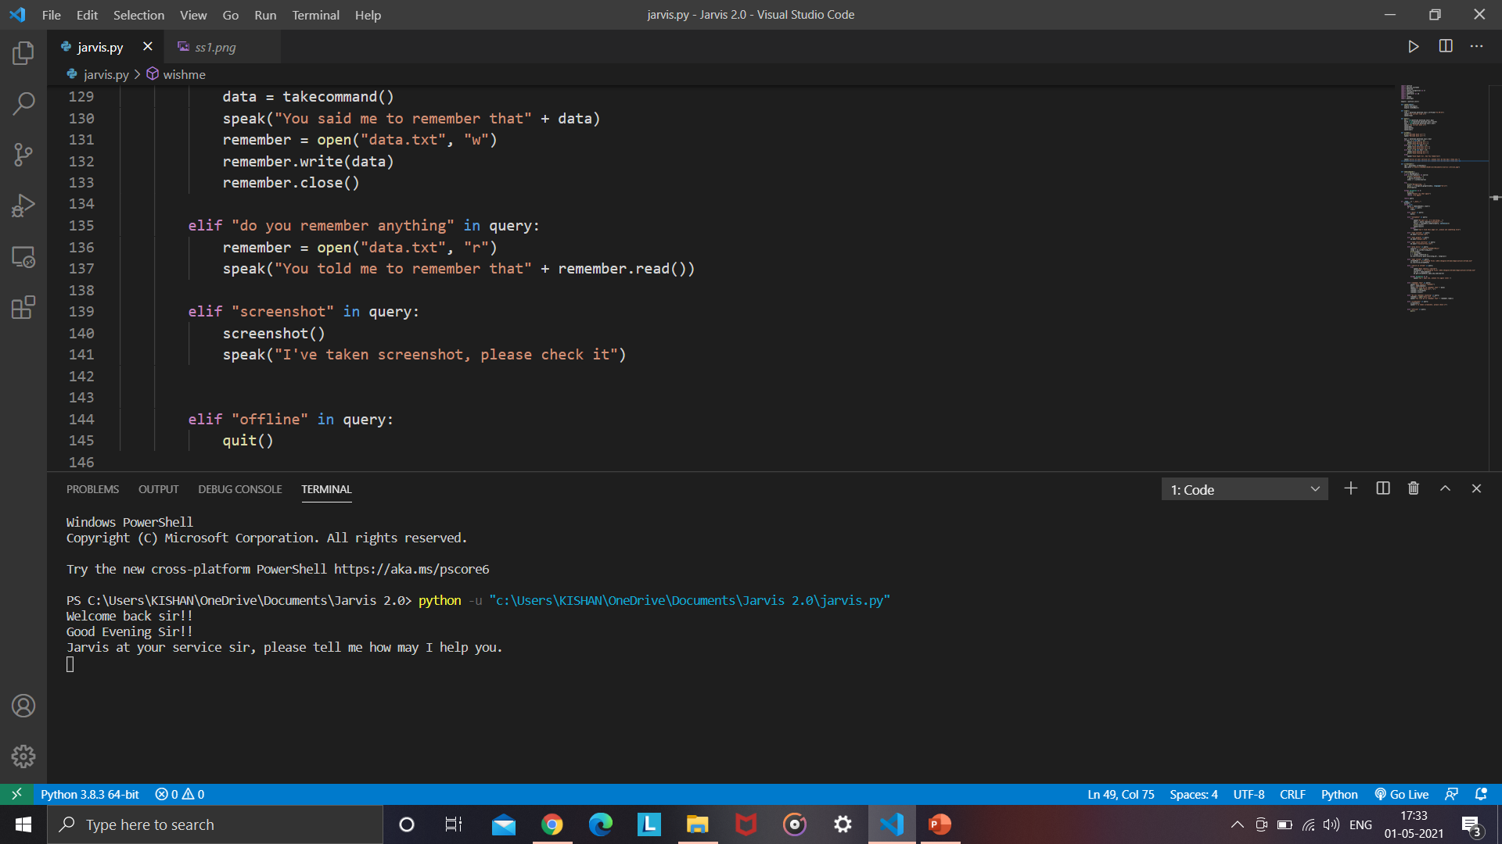
Implementation
Firstly our assistance greet us according to time stamp and then it will asks you to give command to perform

Slide 10
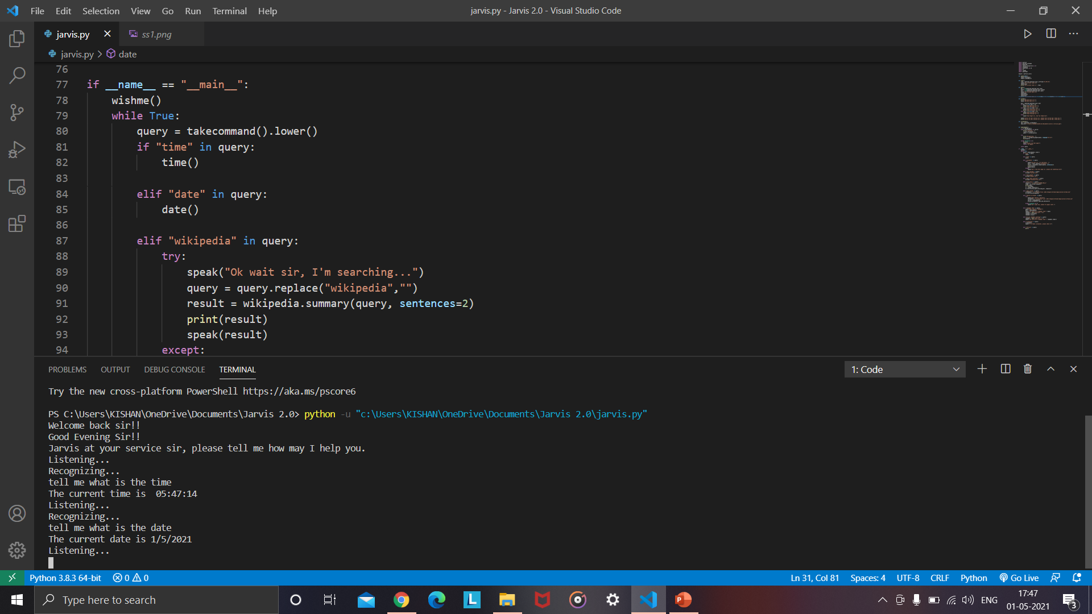
Task 1 :
Calling Time() and Date() Functions

Slide 11
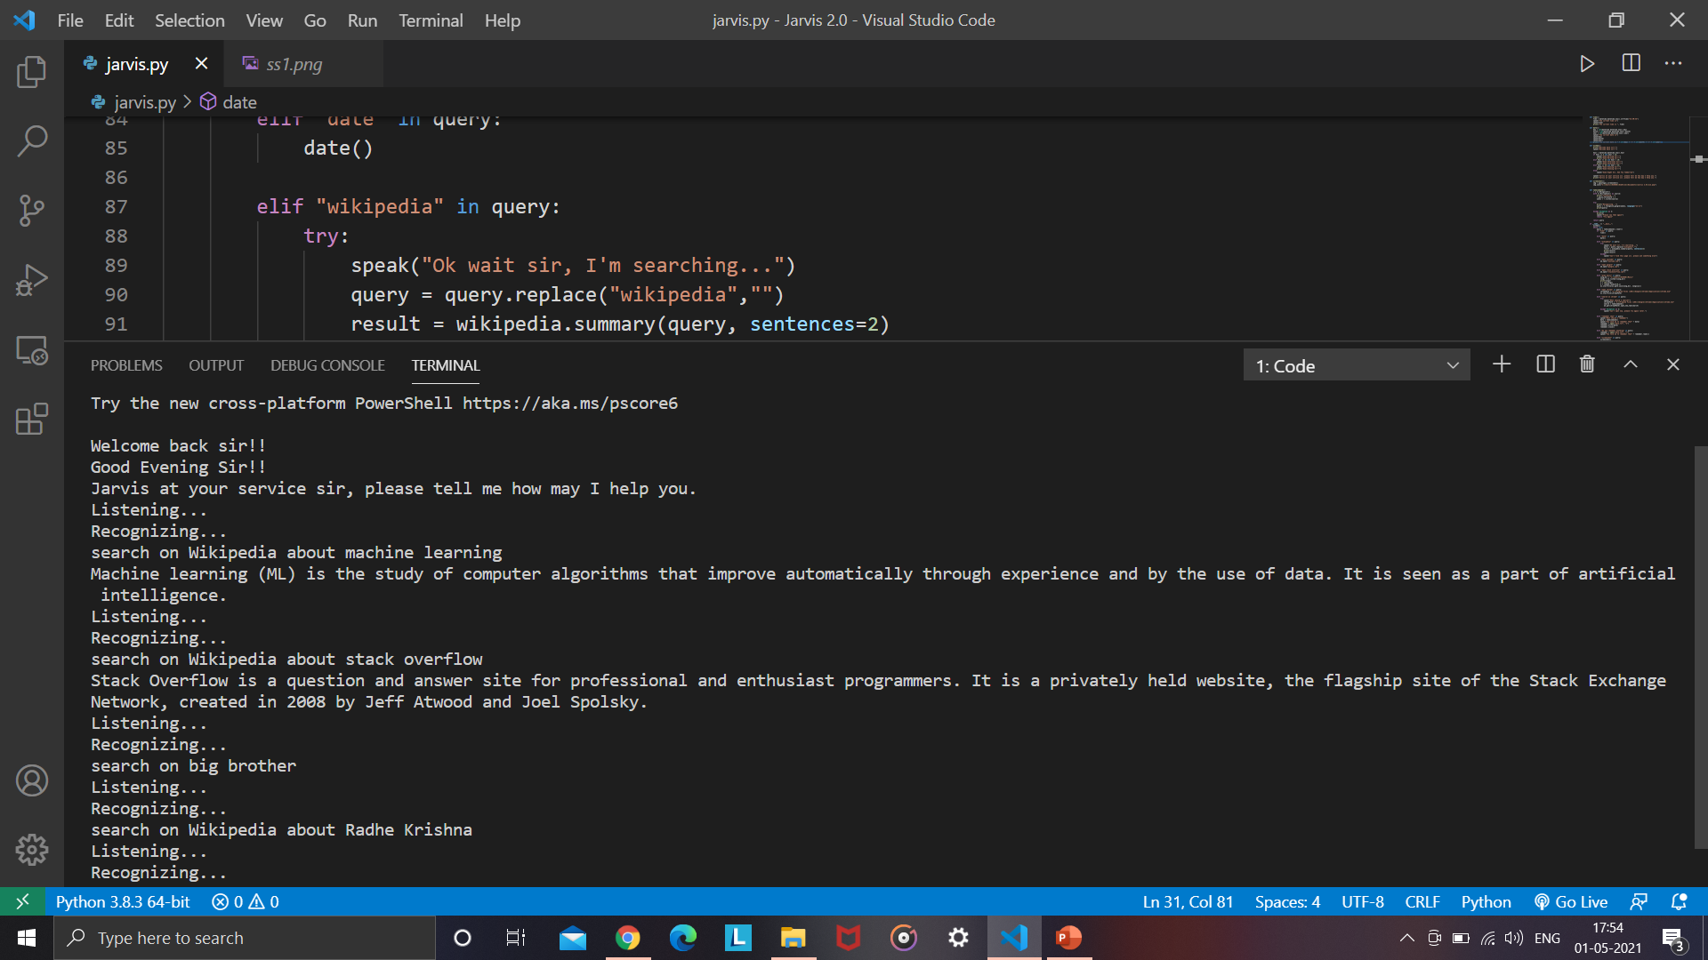
Task 2 :
To search something on Wikipedia
After speaking “Wikipedia” the particular elif statement become true and run the command said by user.

Slide 12
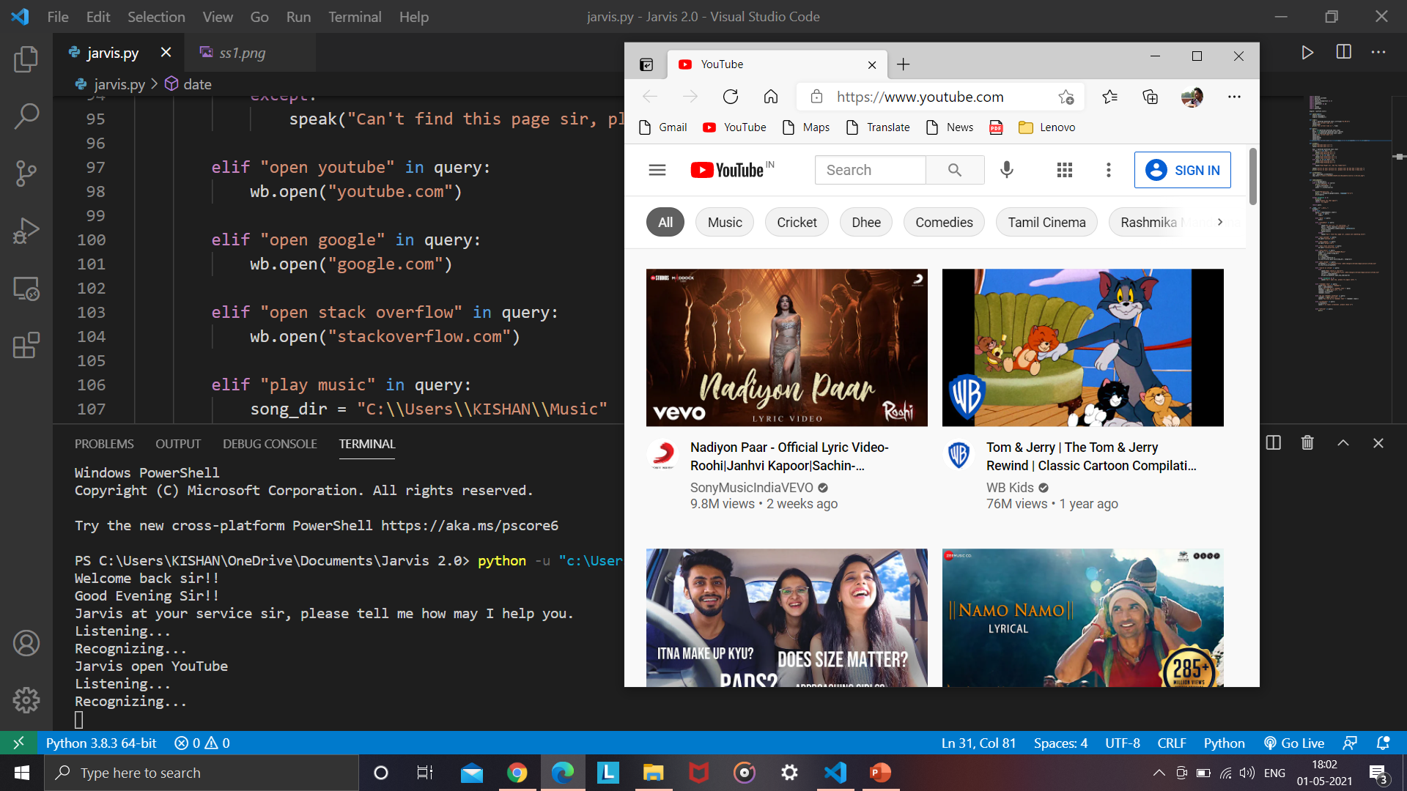
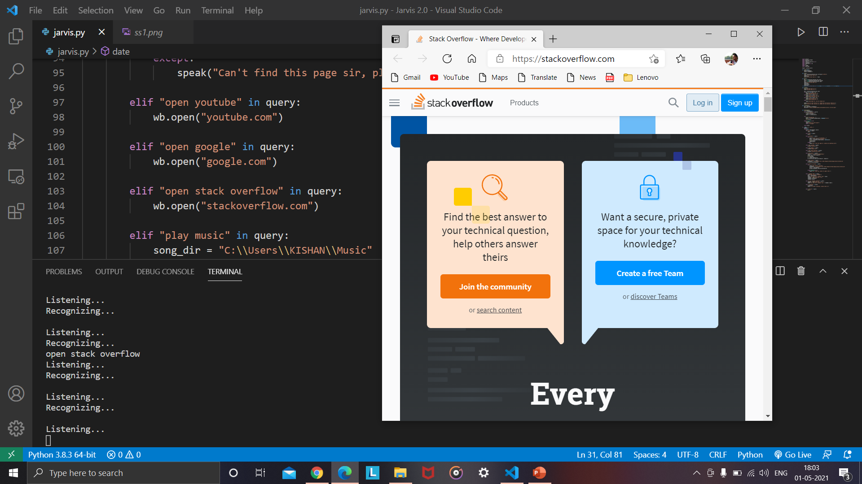
Task 3 :
To open YouTube and Stack Overflow in browser
After speaking “open YouTube” & “open Stack Overflow” the following sites open in browser

Slide 13
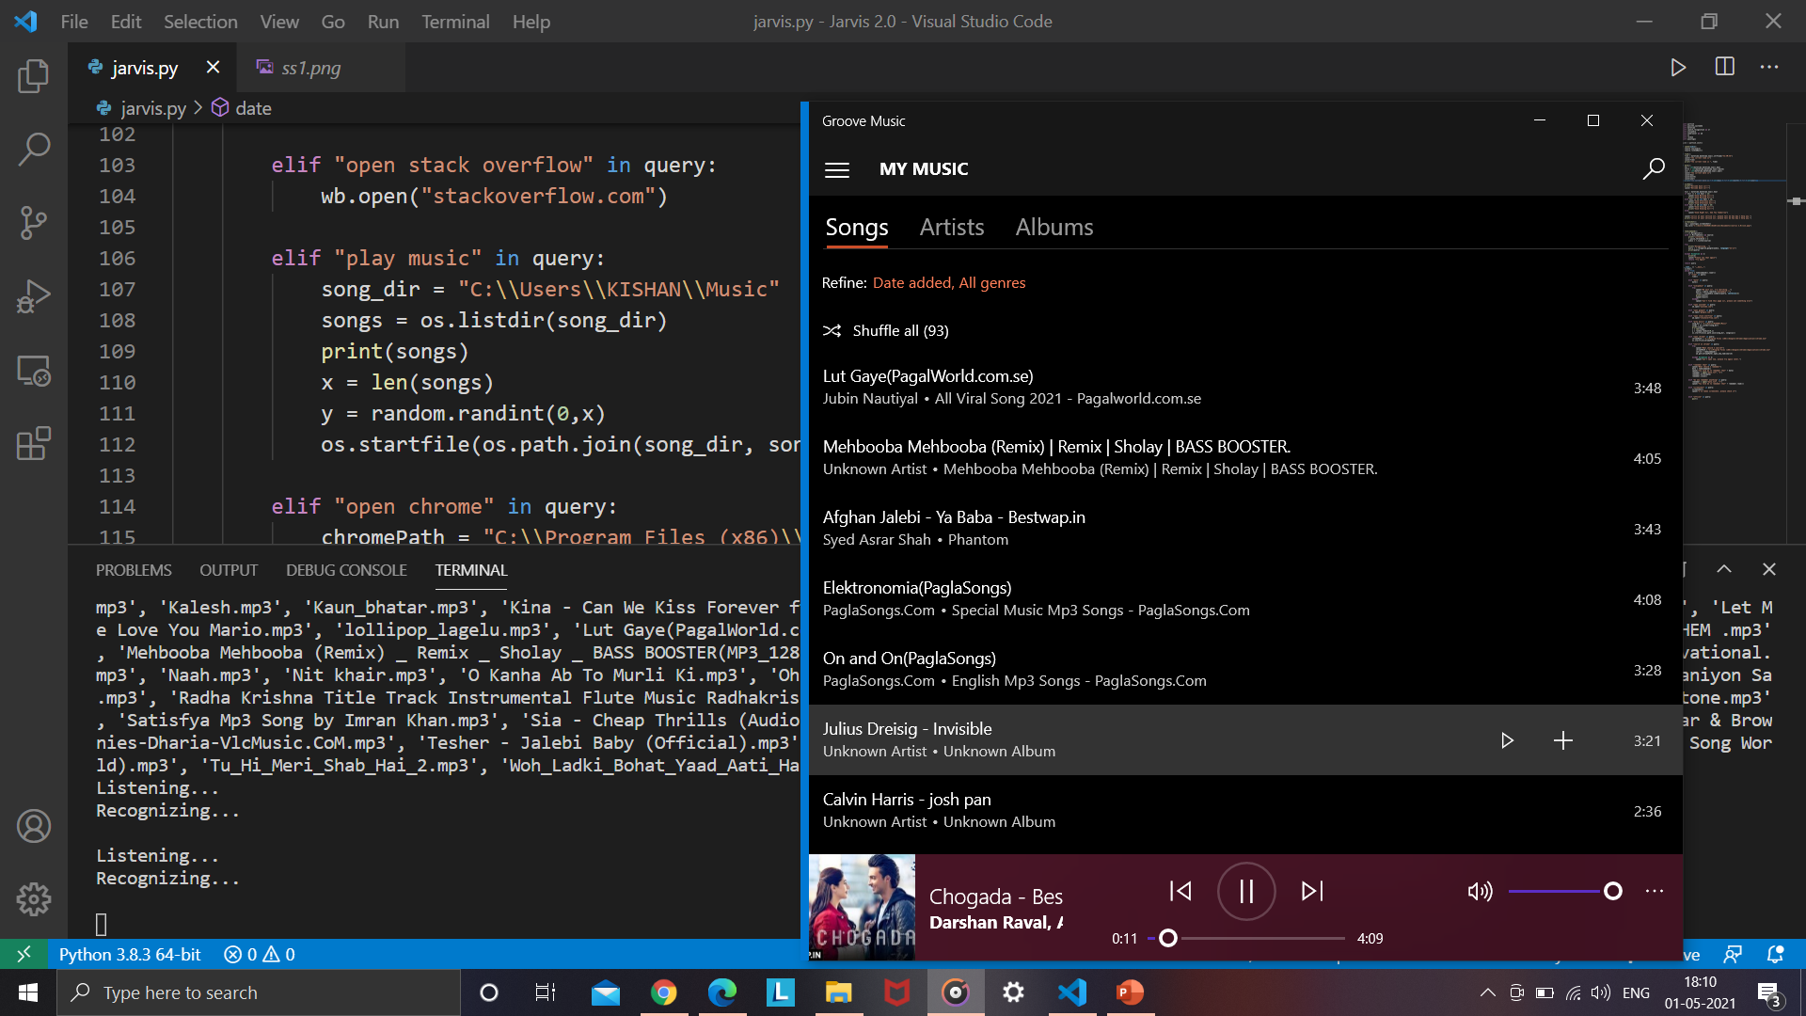
Task 4 :
To Play Music
After speaking “Play Music” the assistant will automatically play a random song which is in user music directory.

Slide 14
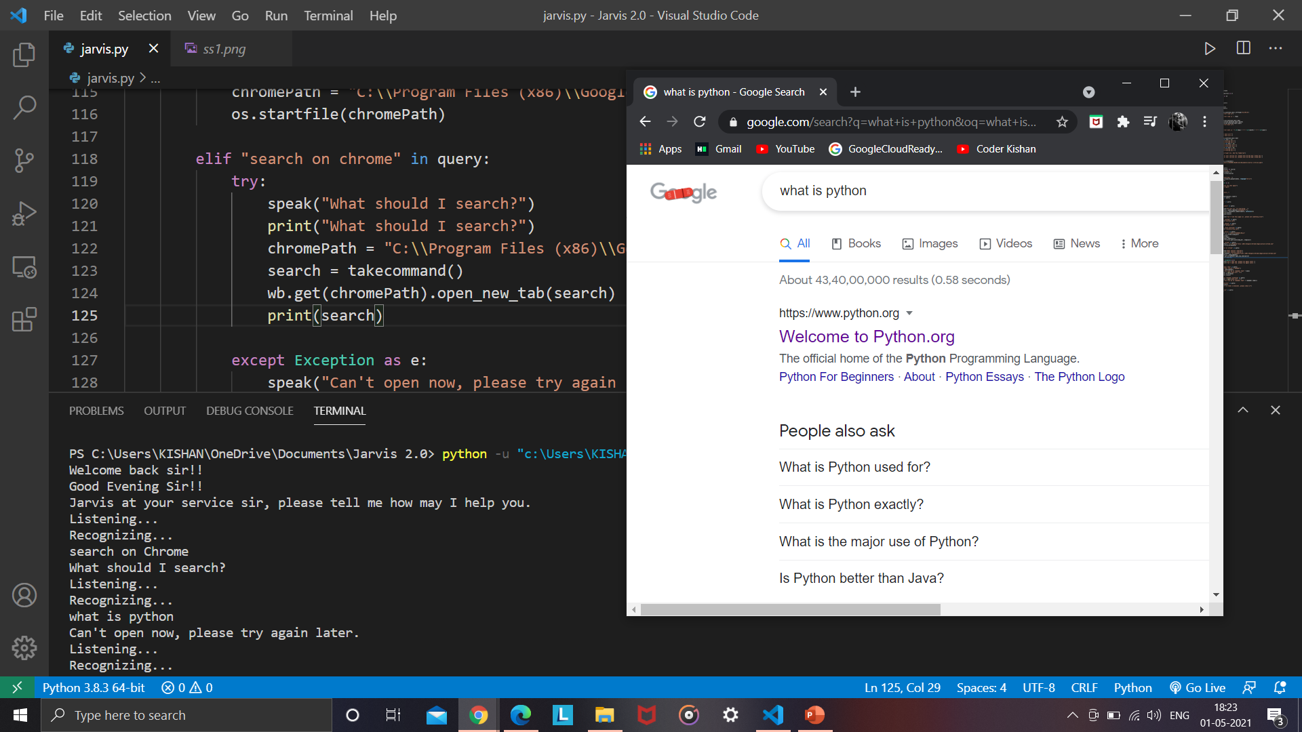
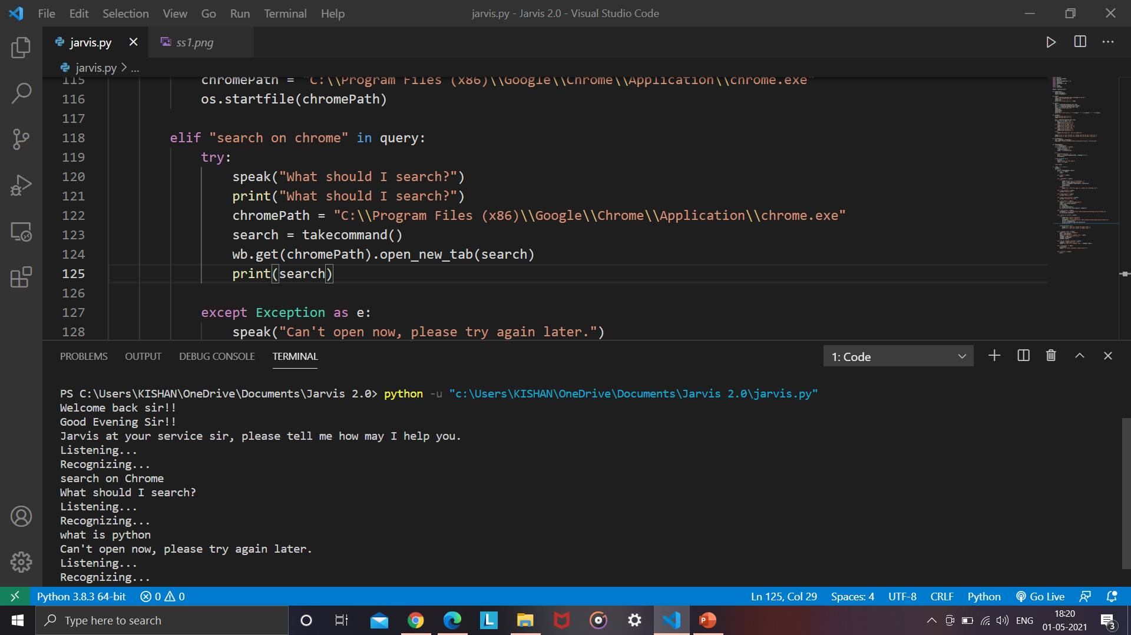
Task 5 :
To search on chrome browser
After speaking “search on chrome” the assistant will search command given by user or if it can’t get that then it will say and print “Can’t open now, please try again later”.

Slide 15
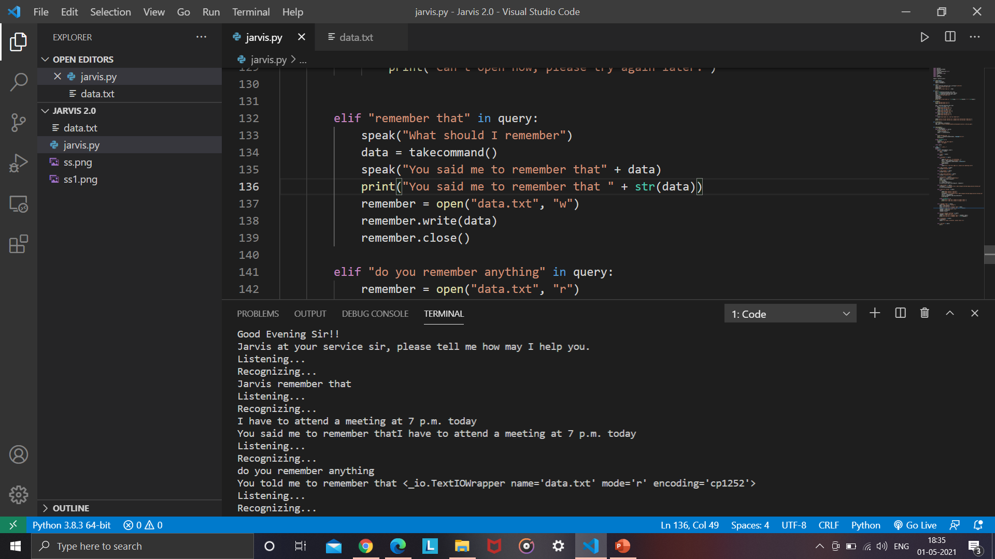
Task 6 :
To remember something
After speaking “remember that” the assistant will ask you that “what should I remember then user tell him particular thing now, if user want to know what assistant remember is then the user has to speak “do you remember anything” then our assistant will tell the user what he told to assistant early.

Slide 16
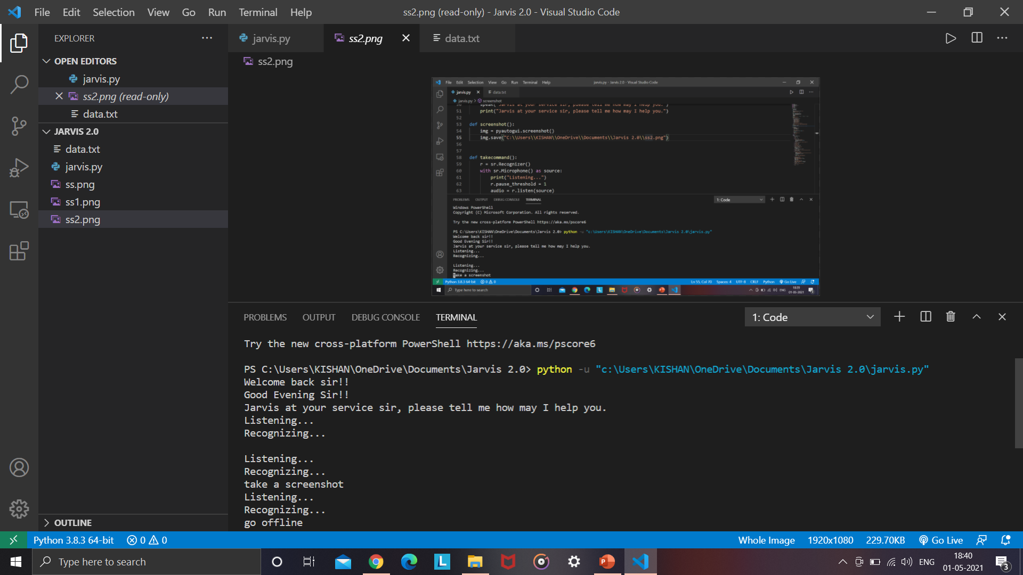
Task 7 :
To take screenshot
After speaking “take a screenshot” the assistant will take screenshot and let you know it has taken screenshot.

Slide 17
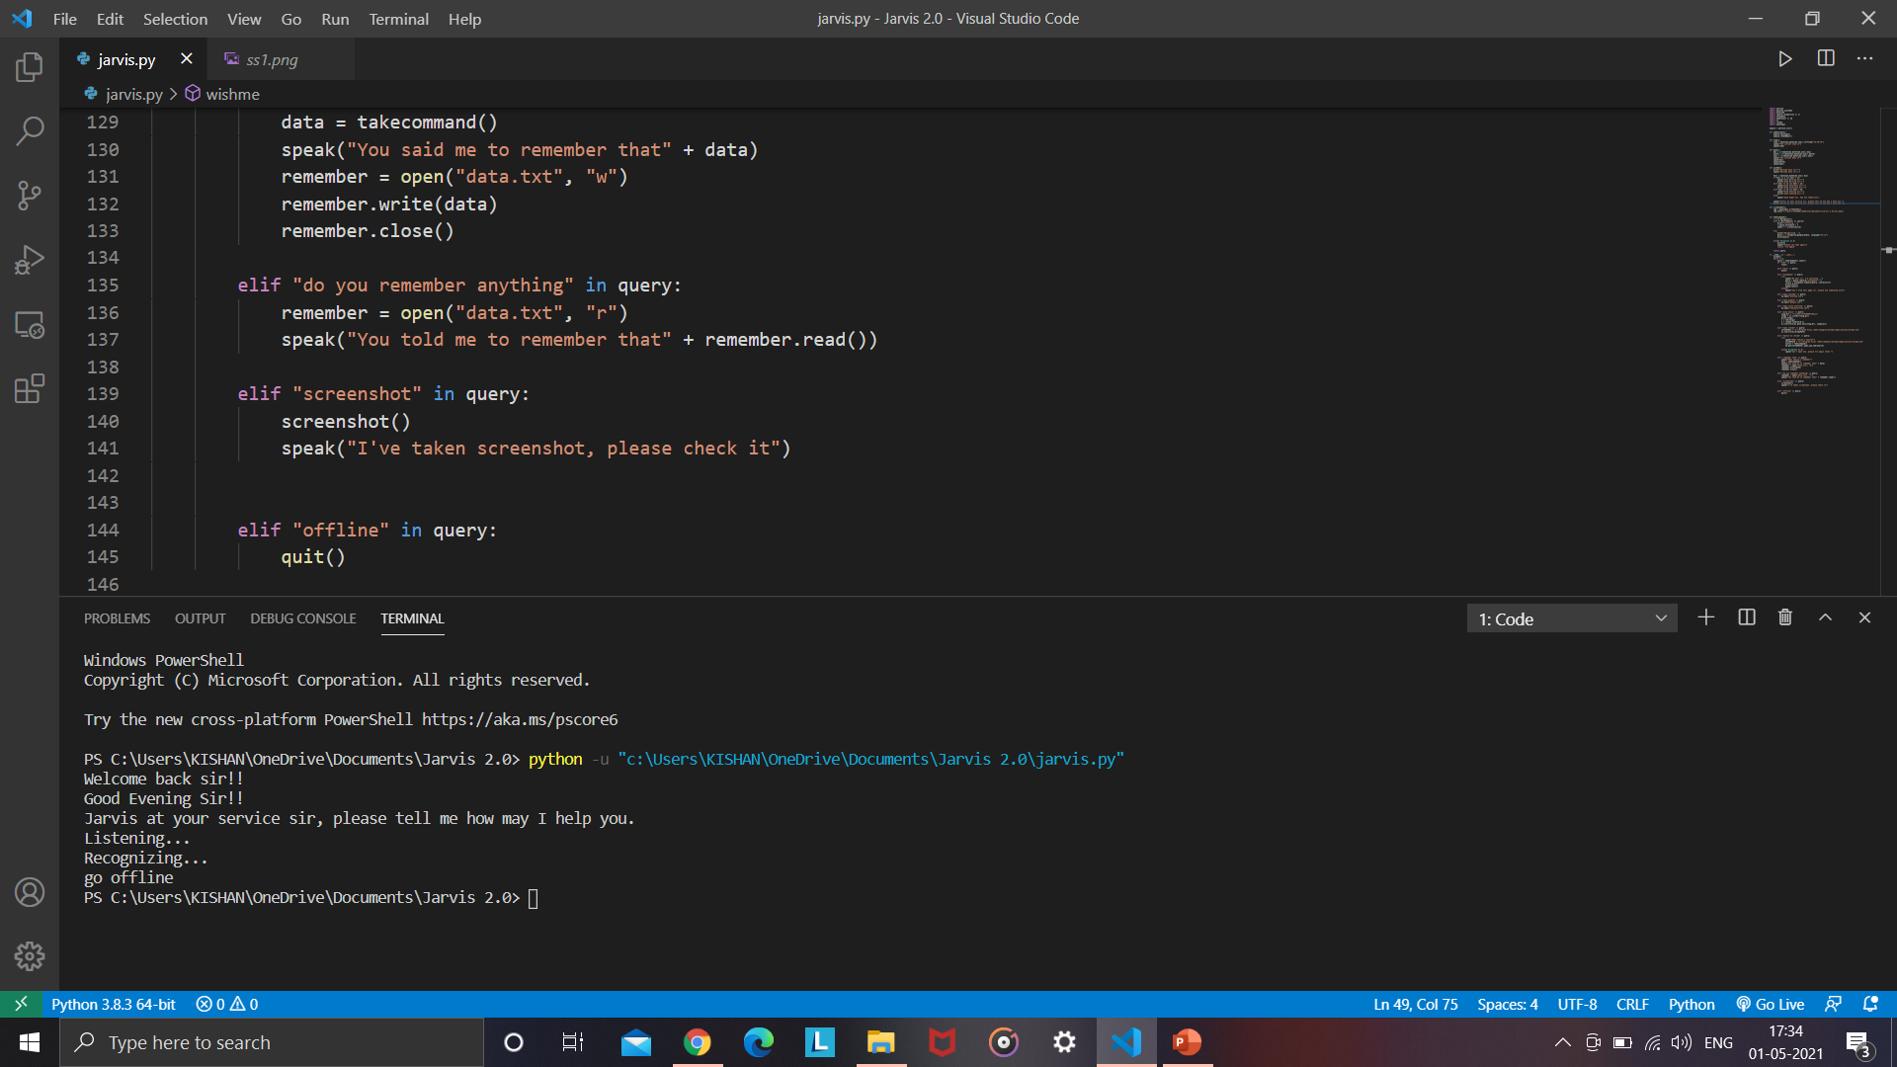
Task 8 :
To make assistant offline
After speaking “go offline” the assistant will offline and then the program will stop.

Slide 18
Advantages:
Disadvantages:
Easy to use
Can work with variety of commands
Custom commands
Secure
Helpful for disabled
Artificial intelligence make advancement in it.
Limited language support
Costly
Expensive equipments
It cannot work in noisy environment
Can’t use for many numbers of people

Slide 19
Scope of the project
Presently, Jarvis is being developed as an automation tool and virtual assistant. Among the Various roles played by Jarvis are:
Search Engine with voice interactions
Medical diagnosis with Medicine aid.
Reminder and To-Do application.
Vocabulary App to show meanings and correct spelling errors.
Weather Forecasting Application.
There shall be proper Documentation available on its Official GitHub repository for making further development easy and we aim to release our virtual assistant as an Open Source Software where modifications and contributions by the community are warmly welcomed.

Slide 20
Conclusion
Through this voice assistant, we have automated various services using a single line command. It eases most of the tasks of the user like searching the web, retrieving weather forecast details, vocabulary help and medical related queries.
We aim to make this project a complete server assistant and make it smart enough to act as a replacement for a general server administration. The future plans include integrating Jarvis with mobile using React Native to provide a synchronized experience between the two connected devices.
Further, in the long run, Jarvis is planned to feature auto deployment supporting elastic beanstalk, backup files, and all operations which a general Server Administrator does. The functionality would be seamless enough to replace the Server Administrator with Jarvis.

Slide 21
REFERENCES
Python : https://www.python.org/
Pyttsx3 : https://cutt.ly/ObvJsYr
Pyaudio : https://cutt.ly/gbvJuT9
YouTube : https://youtu.be/Lp9Ftuq2sVI
Visual Studio Code : https://code.visualstudio.com/

Slide 22
THANK YOU !!

